Slide 1
Tableau 1
File created on: 17-11-2023 10:51:59

Slide 2
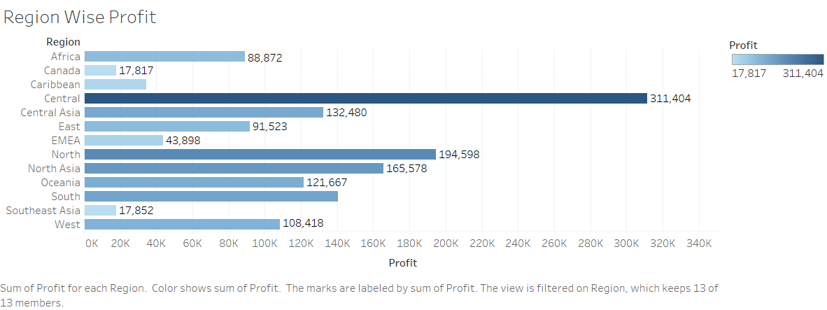

Slide 3
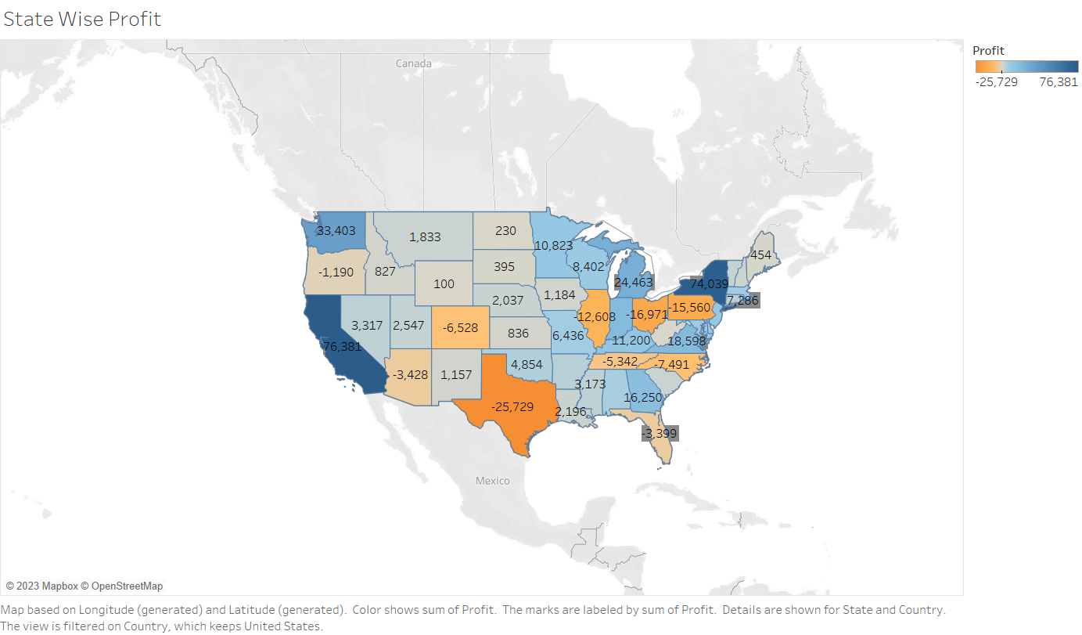

Slide 4
